Slide 1


Team Details
  Team name: AP-ICE
  Team leader name: ADAIKAL SUSAN BESCHI J I
  Problem Statement: Future of Work & Enterprise Productivity

Slide 2
Brief about the idea
Do a task once.
Send it as a link.
IntentLink is a Chrome extension that records a task you do in any web app and turns it into a shareable link. Whoever opens the link has their own AI agent do the same task in their own browser, signed in as them.
The creator writes the limits in plain English. Gemini turns them into rules, and a policy engine outside the model checks every action before it happens.
Don’t send instructions. Send the intent.
01
RECORD
Do the task once, in any web app
02
BOUND
“don’t delete anything”
DENY
delete_*
03
SHARE & RUN
Their agent runs it, inside your rules

Slide 3
Opportunities
1
How is it different?
2
How does it solve the problem?
3
USP
Macro recorders replay clicks and break when a page changes.
AI browser agents adapt, but nothing limits what they do.
IntentLink adapts like an agent and stays bounded like a recording.
No more 14-step docs, screenshots or screen-shares.
The creator shows the task once; the receiver presses Run.
Their agent does it in their own browser, with their own accounts.
The recording is the grant. English is the restriction.
Rules are enforced by code outside the model: the agent cannot talk its way past them.
Every action needs a single-use token, and every block quotes the creator’s own words.
Who it’s for teams onboarding new people · support hand-offs · IT rollouts · anyone who writes “how to” docs

Slide 4
Features offered by the solution
01
02
03
04
Record in any web app
Boundaries in plain English
A consent page per link
Agent in the receiver’s browser
Chrome extension captures each click by role and label, never by screen position.
“Don’t delete anything” becomes DENY delete_*, compiled by Gemini.
Shows what it will do, what is prohibited, and what the receiver can change.
Google ADK + Gemini resolves each step on their page, as them.
05
06
07
08
Policy engine, deny by default
Single-use action tokens
Blocked, in your own words
Parameters & cross-app runs
Allow, ask-first and deny rules checked in code before every action.
Bound to the exact step and element; the extension cannot act without one.
When the agent reaches the line, it stops and quotes the creator’s sentence.
Change a recipient or a theme per run; one link can span several apps.

Slide 5
Process flow
CREATOR
Record the task
Write the limits
Gemini compiles
Share the link
Click through it once, in any web app
“don’t delete anything, ask before sending”
the steps into a workflow and the sentence into rules
published with a consent page, on Cloud Run
RECEIVER
ALLOW token → extension acts
Open & consent
Agent proposes
Policy engine decides
read what it does and what it may never do, press Run
the next action on their page (Google ADK + Gemini)
in code, against the creator’s rules, every action
DENY blocked, rule quoted

Slide 6
Architecture
RECEIVER’S BROWSER
CLOUD RUN · NODE / TS
CLOUD RUN · PYTHON
Chrome extension
publish
redeem
Policy service
Agent (Google ADK)
• Recorder: role + label, no coordinates
• Executor: acts only with a token
• Side panel: live run, verdicts
• Publish: Gemini compiles intent + rules
• Decide & redeem single-use tokens
• Consent, landing, hash-chained audit
• Gemini Flash-Lite picks each action
• before_tool gate asks the policy service
• Holds no authority of its own
decide
page observation → next action
Gemini API
Firestore
Secret Manager
Cloud Build
compile + runtime models
links, policies, audit log
signing secret, API key
images from source
The agent reasons but can’t authorize. The extension acts but can’t authorize. Authority lives in the policy service.

Slide 7
Technologies used
Google AI
Gemini 3.8 Flash
compiles recordings and rules
Gemini 3.5 Flash-Lite
runtime agent
Google ADK 2.11
agent + tool gate
Google Cloud
Cloud Run
policy service + agent
Firestore
links, policies, audit
Secret Manager
Cloud Build
Product
Chrome extension (Manifest V3, TypeScript)
Node.js 26 + TypeScript
Python 3.14 + FastAPI
Zod schemas
signed tokens · hash-chained audit

Slide 8
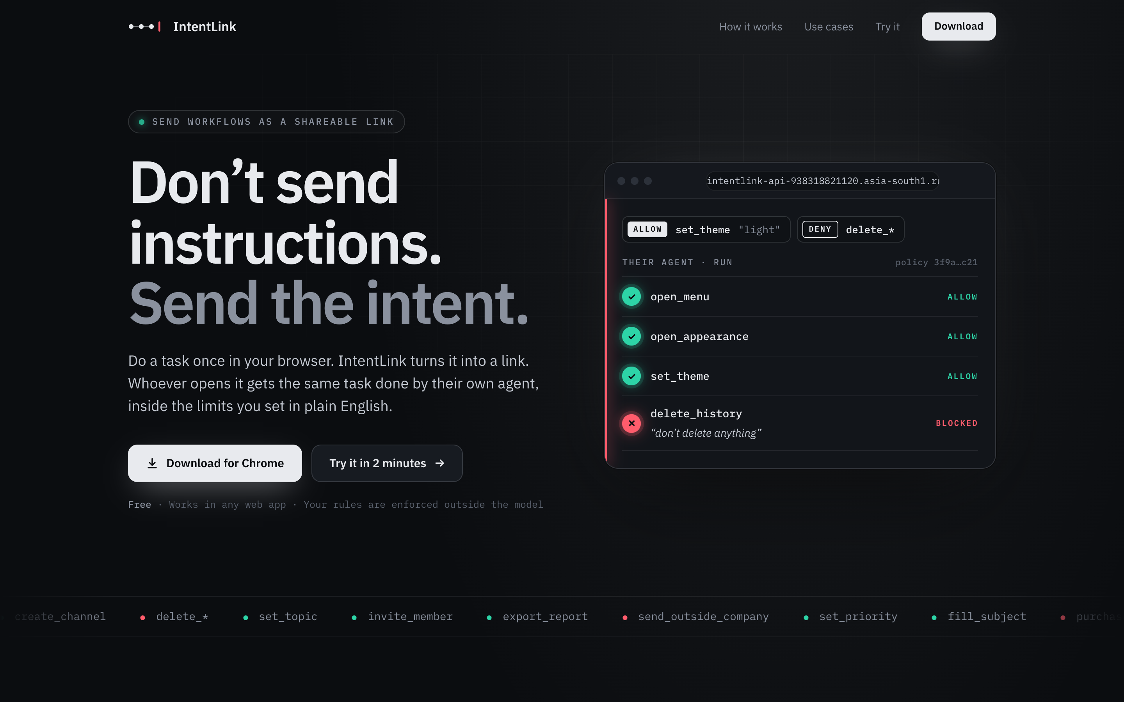
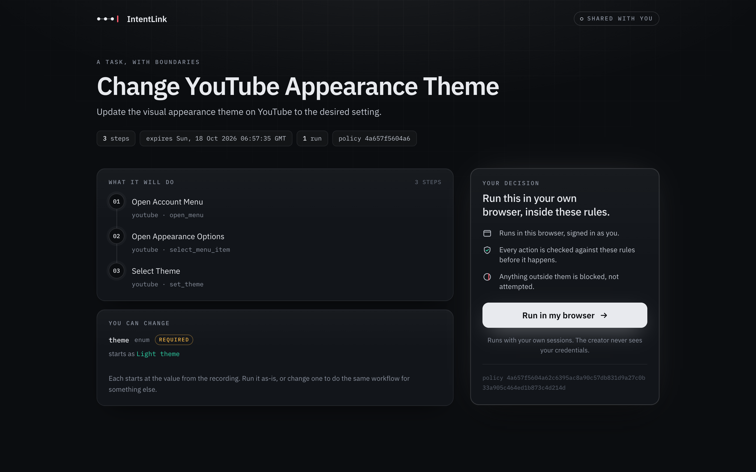
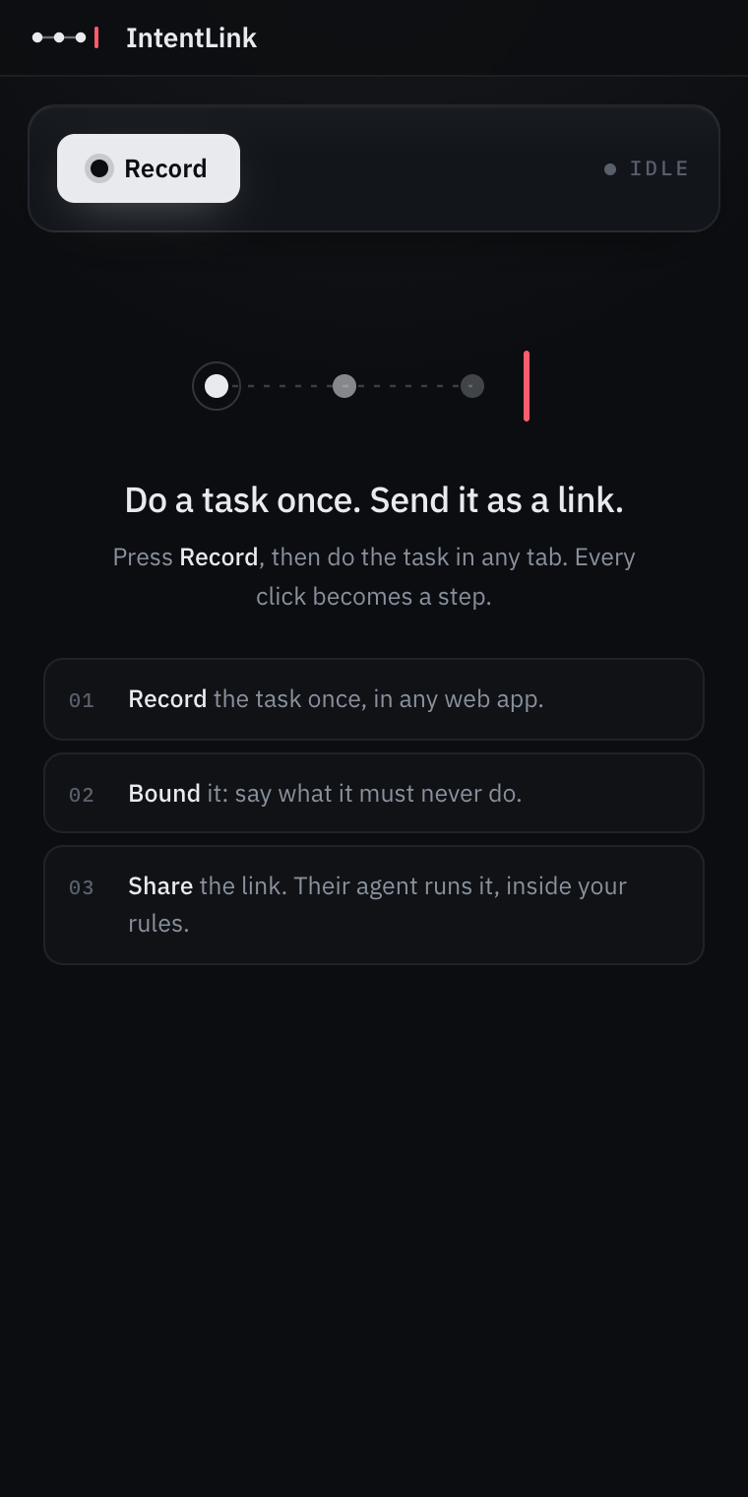
Snapshots of the prototype
Landing page
Live on Cloud Run, with the extension download and a demo link.
Consent page
What the link will do, what it may never do, and what you can change.
Side panel
Record, set limits, watch the run.

Slide 9
Prototype performance
226
~1 s
660×
6 / 6
automated tests passing
per agent step
faster element matching
compile judgments correct
across schema, policy engine, compiler, API, extension and agent
Gemini 3.5 Flash-Lite; steps it can match with certainty skip the model entirely
600 controls: 79.8 s → 121 ms after a one-pass rewrite
Gemini 3.8 Flash on our golden set, vs 3 / 6 for a Pro model
Verified live: a YouTube theme change and a Gmail compose-and-send, each recorded once and run end to end in a receiver’s browser. Creating a link takes 1.5–3 minutes, once, while Gemini compiles the recording and the rules.

Slide 10
Future development
Chrome Web Store listing
one-click install instead of developer mode
Admin guardrails
org-wide rules that every link inherits, on top of the creator’s
1
4
Approvals where people work
“ask me before sending” routed to Slack or email
Scale-out runs
run state in Firestore so the agent scales horizontally
2
5
Team libraries
versioned links, owners, and who-ran-what across an organisation
Narrated recordings
speak while recording; the reasons become part of the intent
3
6

Slide 11
Provide links to your:
GitHub Public Repository: https://github.com/technicalclipper/Intent-Links
Demo Video Link (3 Minutes): to be added after recording
Final Product Link: https://intentlink-api-938318821120.asia-south1.run.app
Try it in 2 minutes
Open the product link, download the extension, load it in Chrome, then open the YouTube demo link on the page and press Run. Your own agent switches YouTube’s theme, and can do nothing else.

Slide 12


